Slide 1

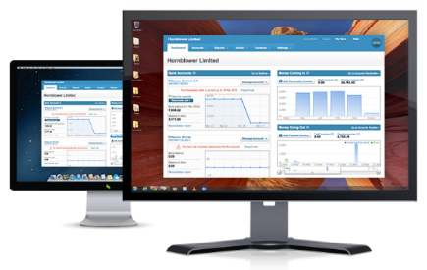




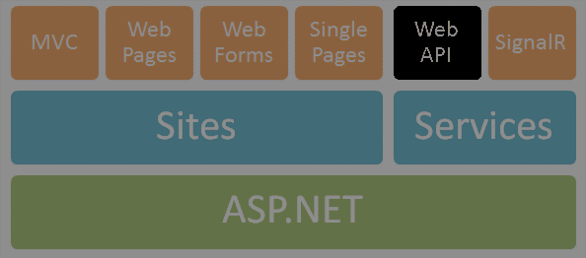
RESTful Services with ASP.NET Web API
Vladimir Georgiev
Technical Trainer &
Software Developer
http://VGeorgiev.org/

Slide 2

Who am I?
Vladimir Georgiev
Microsoft Certified Professional
Software Engineer and Technical Trainer @ Software University
Top performing graduate from the Telerik Software Academy (2013)
Student in Technical University
Computer and Software Engineering
Web site & blog: www.VGeorgiev.org
Twitter: @VGeorgiew

Slide 3


Table of Contents
Distributed Apps and SOA
RESTful Web Services
What is REST?
How to make RESTful web services?
ASP.NET Web API
What is Web API?
Features
Routing
Controllers and actions
How to consume web services?
Development tools

Slide 4




Distributed Apps, Web Services and SOA

Slide 5
Distributed Applications
Most modern applications are distributed
Several components interact with each other
Distributed application models
"Distributed Objects" model – client an server objects
"Client-Server" model – persistent socket / WebSocket connection
"Web Services" model
RESTful (HTTP, REST, JSON)
Heavy services (SOAP, WSDL, XML)

Slide 6
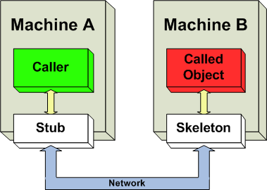
"Distributed Objects" model

Slide 7


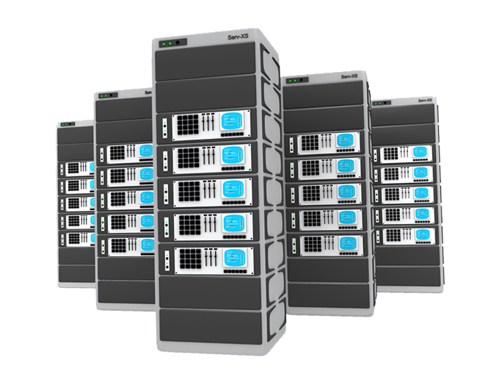


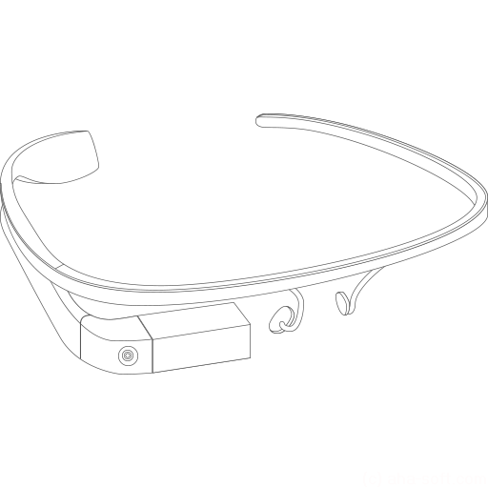

"Client-Server" model
Client
Client
Server
Client
Client
network connection
network connection
network connection
Client
Client

Slide 8
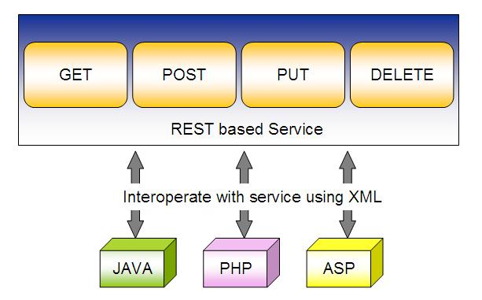
"RESTful Web Services" model

Slide 9

Web Services and Clients
A "web service" is:
Software service that communicates over standard Web protocols
Classical (heavyweight) services use SOAP, WSDL, XML, WS-*
Lightweight (RESTful) services use HTTP, REST and JSON
A "client" (consumer) uses the services
Requests something to be performed
Gets the desired result
Or gets an error
Request-response model: client requests, server responses

Slide 10
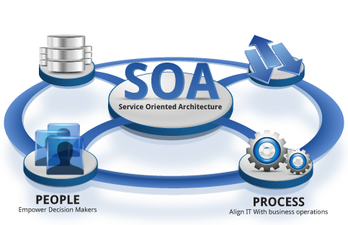
What is Service-Oriented Architecture (SOA)?
SOA (Service-Oriented Architecture) is an architectural concept for development of software systems
Using reusable building blocks (components) called "services"
SOA == decouple the monolithic software to reusable services

Slide 11
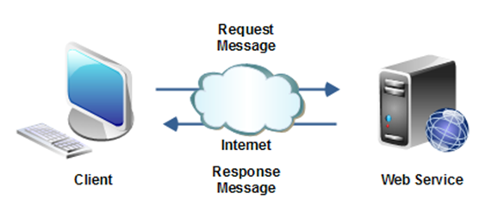
SOA Services
Autonomous
Stateless
Request-response model
Communication through standard protocols
HTTP, FTP, SMTP, RPC, MSMQ, ...
JSON, XML, SOAP, RSS, WS-*, ...
Platform independent
Examples: Google, Amazon, Facebook, Twitter, Parse.com…

Slide 12
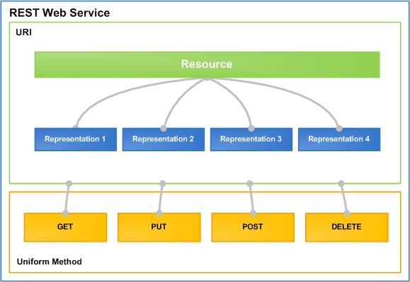
RESTful Web Services
Lightweight Architecture for Web Services

Slide 13
What is REST?
"Representational State Transfer (REST) is a software architecture style consisting of guidelines and best practices for creating scalable Web services."
http://en.wikipedia.org/wiki/Representational_State_Transfer
Application state and functionality are resources
Every resource is associated with unique URI
Each resource supports standard operations (CRUD)
This natively maps to the HTTP protocol
HTTP methods: GET, POST, PUT, DELETE, PATCH, OPTIONS, …

Slide 14
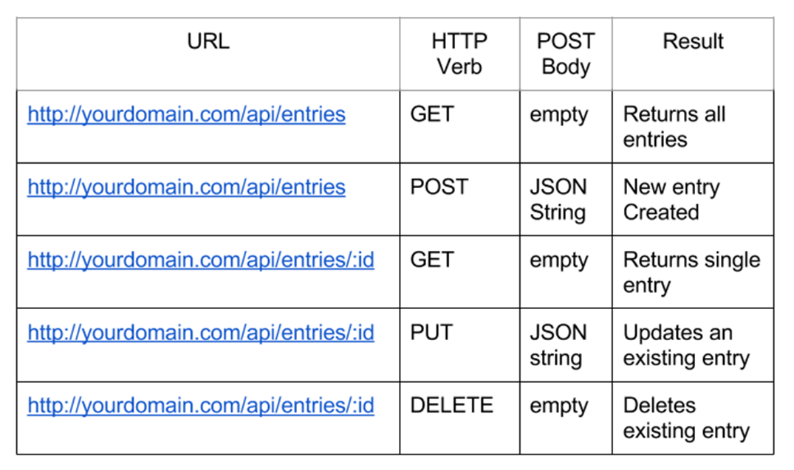
CRUD Operations in REST APIs

Slide 15
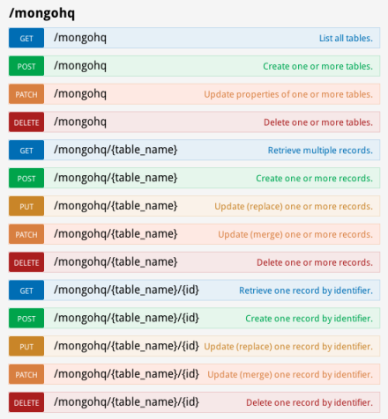
RESTful Web Services and HTTP Methods
One URI per resource
Multiple operations per URI
Get all resources / single resource by ID
GET http://myservice.com/api/Books
GET http://myservice.com/api/Books/3
Add a new resource
POST http://myservice.com/api/Books
Modify (update) a resource
PUT http://myservice.com/api/Books/3

Slide 16
RESTful Web Services and HTTP Methods (2)
Delete (remove) a resource
DELETE http://myservice.com/api/Books/3
Update a resource partially
PATCH http://myservice.com/api/Books/3
Retrieve resource meta-data
HEAD http://myservice.com/api/Books/3
Inspect resource (typically used in AJAX to request permissions)
OPTIONS http://myservice.com/api/Books/3

Slide 17
RESTful API – Example
Server
Web Client (JavaScript and jQuery)
Auth
$.post("api/register", credentials, 'json');
Register
$.post("api/login", credentials, 'json');
Login
$.getJSON("api/users");
Operations
Desktop / Mobile Client (C# / Java / PHP)
Users
Add User
var request = HttpRequest.create("api/users");
response = request.getResponse();
// Parse the response to C# objects
Remove User

Slide 18

What is ASP.NET Web API?

Slide 19
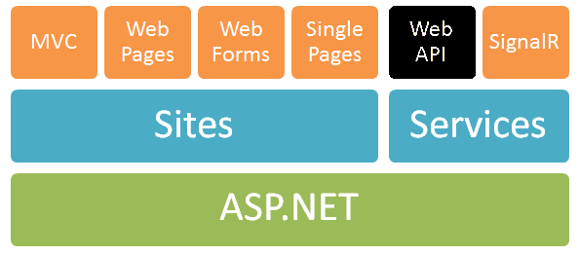
ASP.NET Web API
ASP.NET Web API == platform for building RESTful Web services
Running over the .NET Framework
Using the ASP.NET development stack

Slide 20



ASP.NET Web API
Data storage
XML
HTTP GET
JSON
Data Layer (EF)
ASP.NET Web API
Models
JSON
XML
HTTP PUT, POST, DELETE

Slide 21
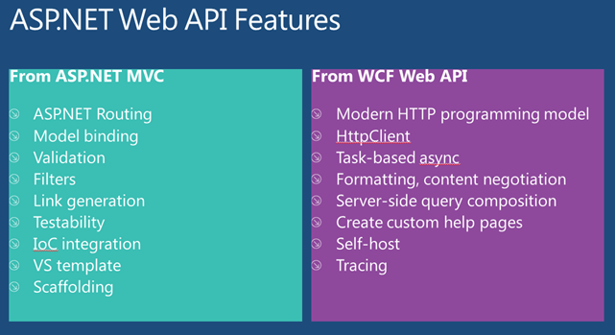
Web API Features
Easy to use framework, very powerful
Modern HTTP programming model
Content negotiation
JSON, XML, Custom formats…
Query composition
Support OData URL over IQueryable<T>
Model binding and validation
Routes (mapping between URIs and code)
Filters, Testability, IoC, Flexible hosting…

Slide 22
ASP.NET Web API 2
Attribute routing
OData improvements: $select, $expand, $batch, $value
Request batching
Portable ASP.NET Web API Client
Improved testability
CORS (Cross-origin resource sharing)
Authentication filters
OWIN support and integration (owin.org)

Slide 23
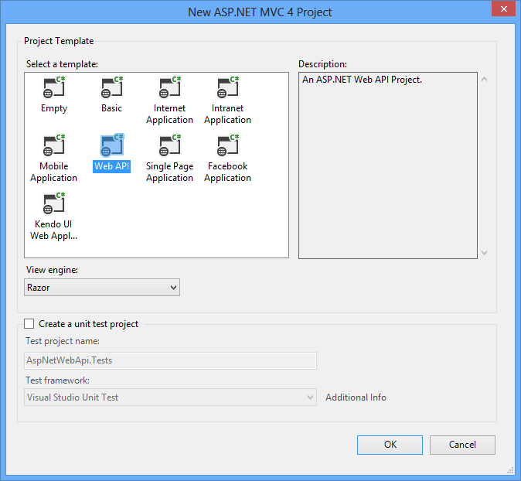
Creating ASP.NET Web API Project
Default ASP.NET Web API Project Template

Slide 24

Web API Controllers

Slide 25
Web API Default Behavior
1
2
3
Web Request
Match a Route
API Controller Responds
http://localhost:1337/api/posts
HTTP GET Request
Controller Name
public class PostsController : ApiController
{
public string Get()
{
return "Some data"; }
}

Slide 26
Web API Controllers
A controller class handles HTTP requests
Web API controllers derive from ApiController
ASP.NET Web API by default maps HTTP requests to specific methods called "actions"
Action | HTTP method | Relative URI | Method
Get a list of all posts | GET | /api/posts | Get()
Get a post by ID | GET | /api/posts/id | Get(int id)
Create a new post | POST | /api/posts | Post(PostModel value)
Update a post | PUT | /api/posts/id | Put(int id, PostModel value)
Delete a post | DELETE | /api/posts/id | Delete(int id)
Get a post by category | GET | /api/posts?category=news | Get(string category)

Slide 27
Routing
Routing == matching URI to a controller + action
Web API support the full set of routing capabilities from ASP.NET (MVC)
Route parameters
Constraints (using regular expressions)
Extensible with own conventions
Attribute routing is available in version 2

Slide 28
Default Route
Web API also provides smart conventions by default
We can create classes that implement Web APIs without having to explicitly write code
HTTP Verb is mapped to an action name
http://localhost:1337/api/posts
routes.MapHtpRoute(name: "DefaultApi",
routeTemplate: "api/{controller}/{id}",
defaults: new { id = RoutesParameter.Optional });

Slide 29

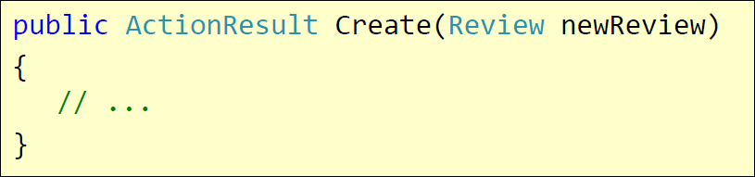
Model Binding & Validation
By default the Web API will bind incoming data to POCO (CLR)
Will look in body, header and query string
Validation attributes can also be used
HTTP POST /Review/Create
Rating=7&Body=Great!
DefaultModelBinder

Slide 30
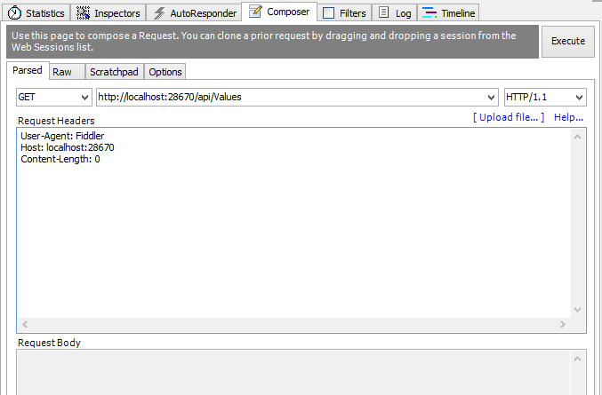
Demo: Create API Controller

Slide 31
Return Different HTTP Code
By default when everything is OK, we return HTTP status code 200
Sometimes we need to return error
public HttpResponseMessage Get(int id)
{
if (dataExists)
{
return Request.CreateResponse(HttpStatusCode.OK, data);
} else
{
return Request.CreateErrorResponse( HttpStatusCode.NotFound, "Item not found!");
} }

Slide 32
OData Query Syntax
OData (http://odata.org) is a open specification written by Microsoft
Provide a standard query syntax on resources
Implemented by WCF Data Services
ASP.NET Web API includes automatic support for this syntax
Return IQueryable<T> instead of IEnumerable<T>

Slide 33
OData Query Syntax
To enable OData queries uncomment the line:
"config.EnableQuerySupport();"
Then we can make OData queries like:
http://localhost/Posts?$top=2&$skip=2
Option | Description
$filter | Filters the results, based on a Boolean condition.
$inlinecount | Tells the server to include the total count of matching entities in the response.
$orderby | Sorts the results.
$skip | Skips the first n results.
$top | Returns only the first n the results.

Slide 34

Web API Clients

Slide 35
HttpClient Model
HttpClient is a modern HTTP client for .NET
Flexible and extensible API for accessing HTTP
Has the same programming model as the ASP.NET Web API server side
HttpRequestMessage / HttpResponseMessage
Uses Task pattern from .NET 4.0
Can use async and await keywords in .NET 4.5
Installs with ASP.NET MVC 4
Can be retrieved via NuGet

Slide 36
Consuming Web API from C#
var client = new HttpClient { BaseAddress = new Uri("http://localhost:28670/") };
client.DefaultRequestHeaders.Accept.Add(new
MediaTypeWithQualityHeaderValue("application/json"));
HttpResponseMessage response = await client.GetAsync("api/posts");
if (response.IsSuccessStatusCode)
{
var products = await response.Content.ReadAsAsync<IEnumerable<Post>>();
foreach (var p in products)
{
Console.WriteLine("{0,4} {1,-20} {2}", p.Id, p.Title, p.CreatedOn);
}
}
else
{
Console.WriteLine("{0} ({1})", response.StatusCode, response.ReasonPhrase);
}

Slide 37
Consuming Web API from JavaScript
Web APIs can be consumed using JavaScript via HTTP AJAX request
Example with jQuery:
<ol id="posts"></ol>
<script>
$.ajax({
url: '/api/posts',
success: function (posts) {
var list = $('#posts');
for (var i = 0; i < posts.length; i++) {
list.append('<li>' + posts[i].title + '</li>');
}
}
});
</script>
Should be encoded

Slide 38
Demo: Consume Web API from Console Application

Slide 39
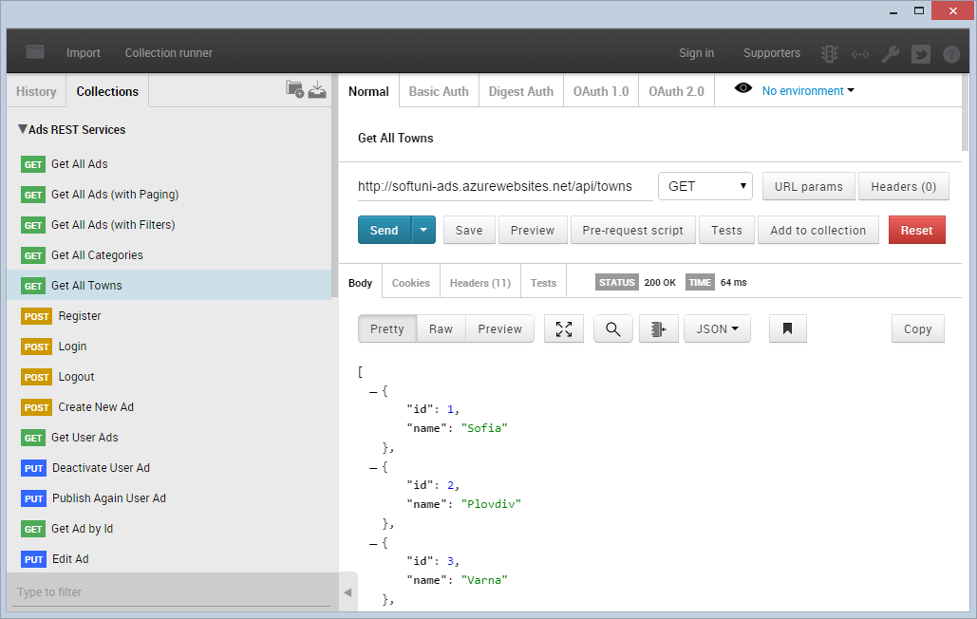
Postman – REST Client

Slide 40
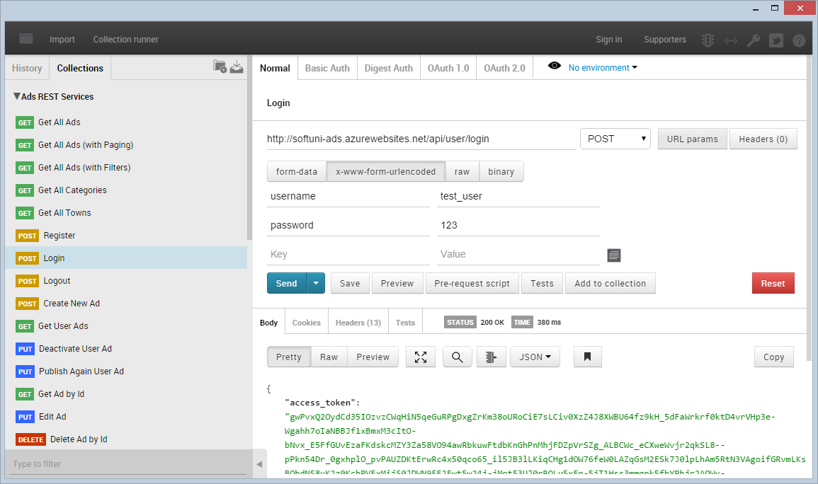
Postman
Live Demo

Slide 41









Web Services and Cloud
https://softuni.bg/courses/web-services-and-cloud/

Slide 42
License
This course (slides, examples, demos, videos, homework, etc.) is licensed under the "Creative Commons Attribution-NonCommercial-ShareAlike 4.0 International" license
Attribution: this work may contain portions from
"Web Services and Cloud" course by Telerik Academy under CC-BY-NC-SA license

Slide 43





Free Trainings @ Software University
Software University Foundation – softuni.org
Software University – High-Quality Education, Profession and Job for Software Developers
softuni.bg
Software University @ Facebook
facebook.com/SoftwareUniversity
Software University @ YouTube
youtube.com/SoftwareUniversity
Software University Forums – forum.softuni.bg

